Slide 1
Microsoft Identity Virtual Onsite Partner Track
June 2020

Slide 2
Azure AD Configuration Assessment
Uday Shivaswamy, Ehud Itshaki
Program Managers
Microsoft Identity Division - Customer Experience Team

Slide 3
Assessment Walk-through
Goals of the assessment
Provide Insights from your own data
Improve Identity and Access Management Posture
Two-way discussion
Findings are based on lessons learned / real world experience across large enterprise customers
We want to learn if/how recommendations fit in your environment and requirements

Slide 4
Engagement Model

Slide 5
How does it work?
Customer Stakeholders
IAM Team: Architect and Operations
InfoSec Team: Architect and Operations
Cloud resources (Azure): Architect and Operations
Microsoft Stakeholders
Azure AD Team: GTP PM
Microsoft: ATS, TAM, CSM

Slide 6
How does it work?
Delivery Stages
Phase 1: Gather information
Phase 2: Present findings
Phase 3: Plan remediation

Slide 7
Phase 1: Gather Information
Customer Interview (Architect Team and Ops Team) – 3 hours
IAM + Infosec: walks through Azure AD Portal
Productivity: walks through Office Admin Portal
Cloud Resources: Walks through Azure EA portal
IAM: walks through On-prem components (Azure AD Connect, AD FS, Proxy Connectors, etc.)
Interview
IAM: run read-only scripts and tools to extract information

Slide 8
Phase 1: Gather Information
What information do we collect with the scripts?
List of UPN, name and email address of users with privileged roles
Application Group and User Assignment
List of Application Consent Grants
Metadata of Credentials used by Service Principals
Snapshot of Azure AD Connect configuration
AD FS Application Configuration (if applicable)

Slide 9
Phase 1: Gather Information
How is the data stored and handled?
We need to agree upon an information sharing mechanism (MS Teams site hosted by the customer preferable)
It will be locked down to customer team members and GTP PM
GTP PM require to download the files generated by the scripts to produce the reports in a Microsoft Managed Device and Security Policies

Slide 10
Phase 2: Present Findings
GTP Team (offline, no customer time investment)
Analyze data gathered in phase 1
Prepare deliverables
Deliverables
Recommendation slide deck
Reference document with detailed description of checks
Power BI model
Categories of Recommendations
Simple config changes
Deployment Projects
IT Process Considerations

Slide 11
Phase 2: Present Findings (cont’d)
Delivery Workshop – 3 hour workshop
Audience: Architect team(s)
Discussion on the findings / Q & A
Color findings based on customer(s) environment
Closure
Provide collateral for customer reference

Slide 12
How we will present results
Assessment Breakdown
Area
Checks
Summary
Recommendations

Slide 13
How we will present results
Recommendation Nomenclature
P0: As soon as possible
P1: Next 30 days
P2: Next 60 days
P3: Later

Slide 14
How we will present results
Collateral
Slide Deck with Summary and Recommendations
Document with detailed reference of Checks performed
Power BI Model with Data Insights
Detailed AD Sync Configuration Summary
Detailed AD FS to Azure AD App Migration Analysis

Slide 15
Phase 3 : Plan Remediation
Follow up discussion with GTP PM
Triage and prioritize remediation activities
Incorporate remediation projects in portfolio
Recommended: Schedule re-assessment

Slide 16
Categories

Slide 17
Disclaimers
The recommendations provided will be current by the date of the engagement. Landscape and surface area changes constantly, and customers should be continuously evaluating their IAM practices as Microsoft products and services evolve over time
The recommendations will be provided based on the data provided during the interview, and telemetry.
The recommendations here covers several IAM areas, but there is no warranty of absolute coverage

Slide 18
Identity and Access Management Areas
Identity Management
Identity Lifecycle (Joiners/Movers/Leavers)
Entitlement Management
Access Management
Credential Management
Authentication
Single Sign On
Application Access Policies
Device Management
Usage Analytics

Slide 19
Identity and Access Management Areas
Governance
Attestation
Auditing
Privileged Accounts
Operations
Service and Infrastructure Health
Supportability

Slide 20
Real world walk through – Power BI report

Slide 21
Power BI report
This report is the analysis of the data collected
The interview is another key component of the data collection – identifies gaps in processes and operations
Together, they are basis for all the findings and recommendations of the assessment

Slide 22
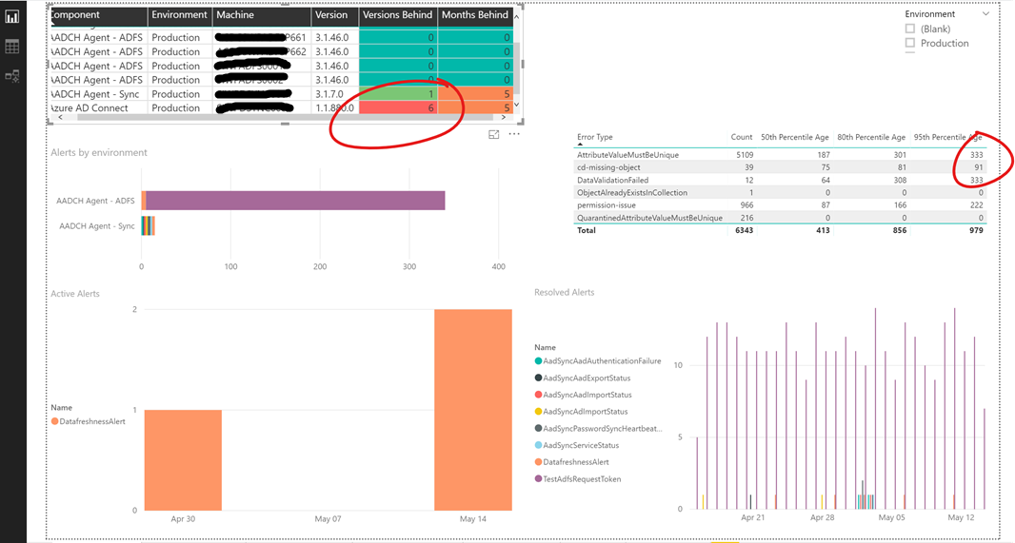
The basics – Sync & Connect Health

Slide 23
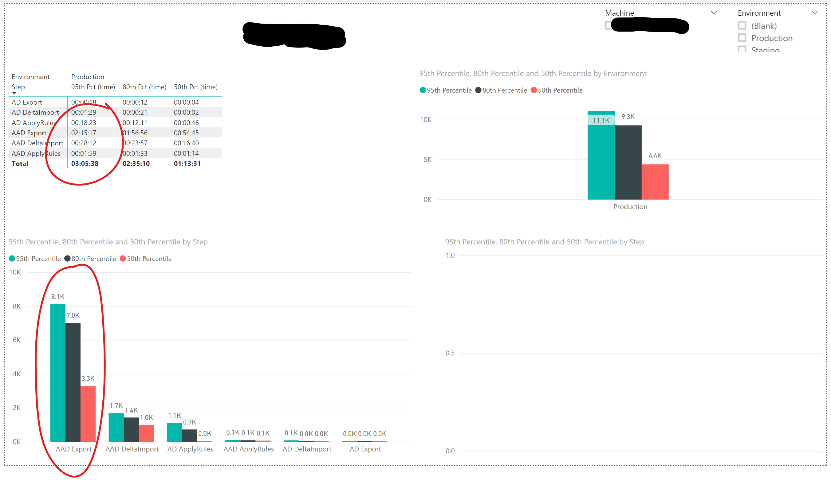
Sync Performance

Slide 24
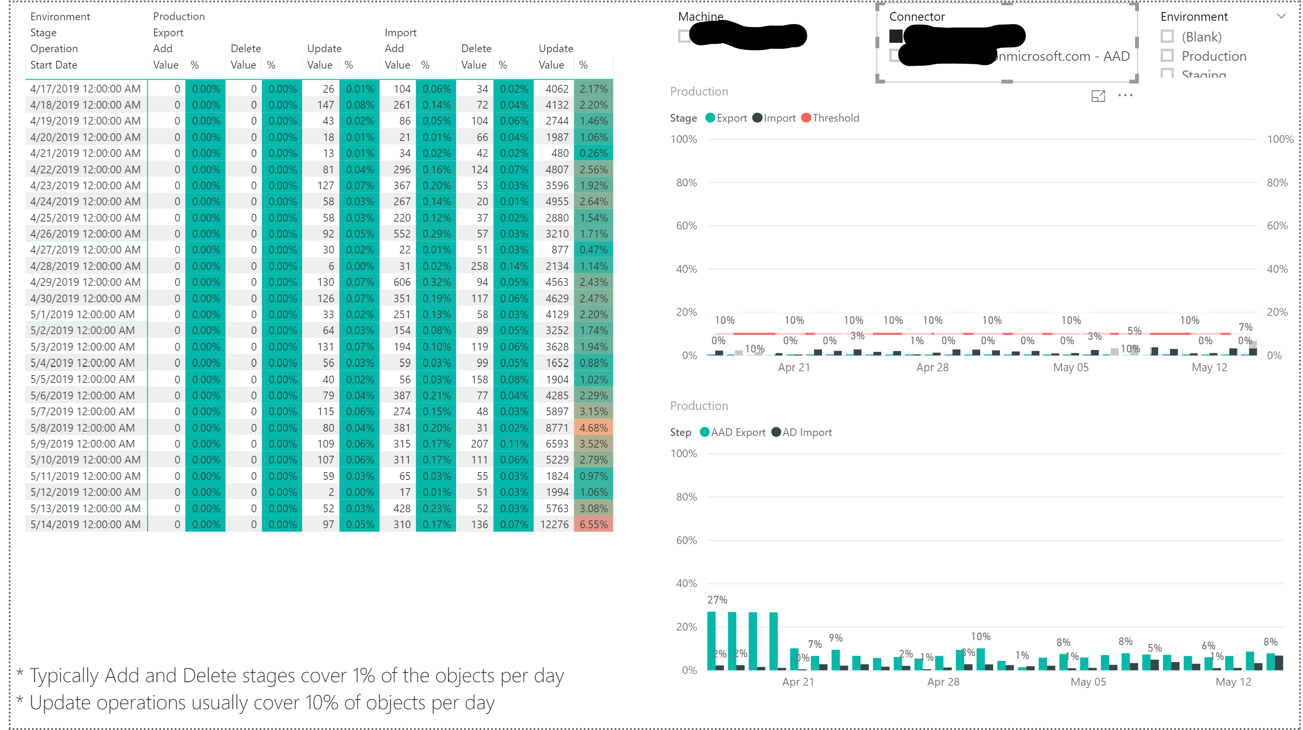
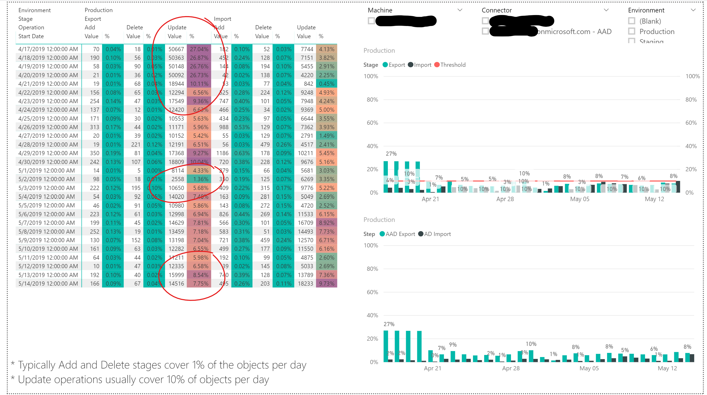
Sync – Object Counts

Slide 25
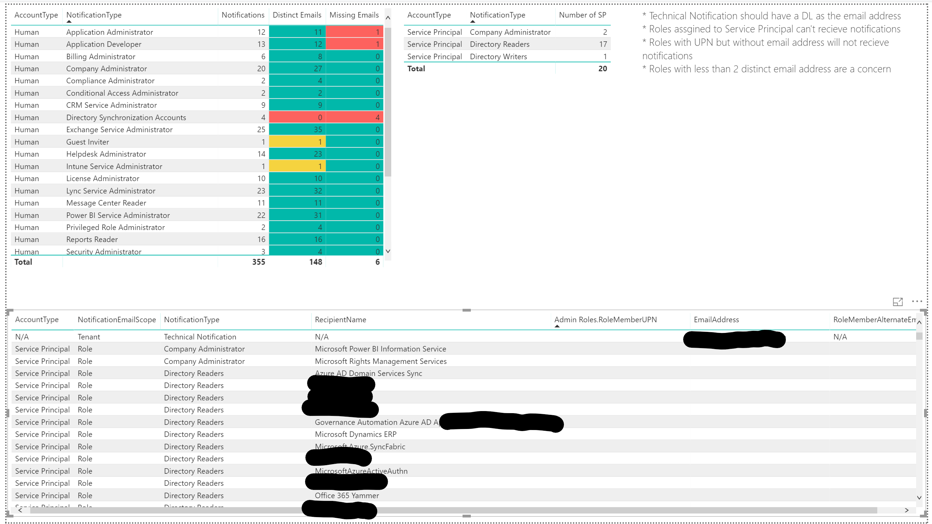
Roles & Notifications

Slide 26
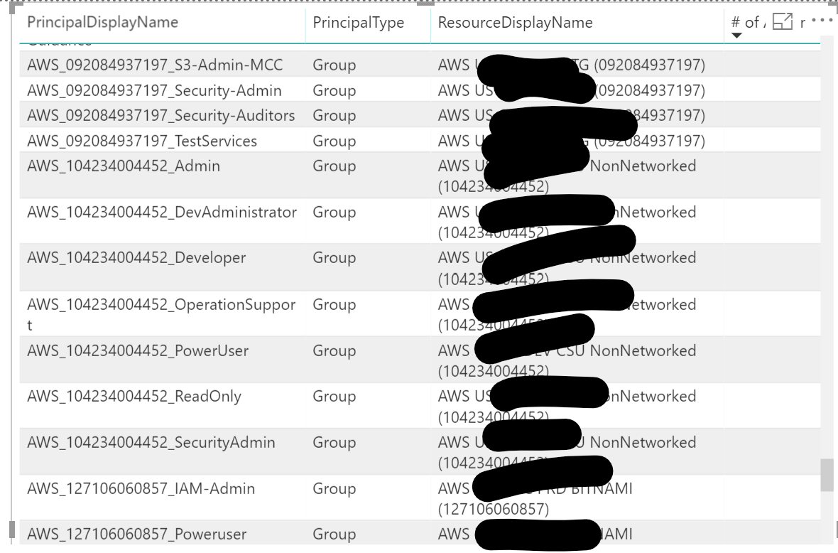
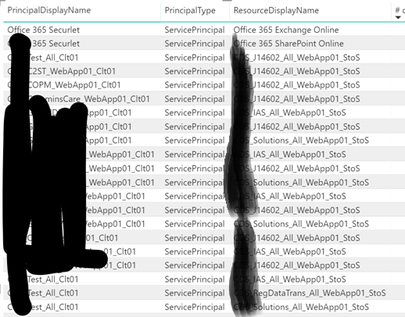
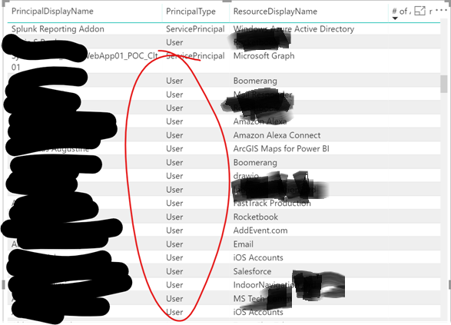
App Assignments

Slide 27
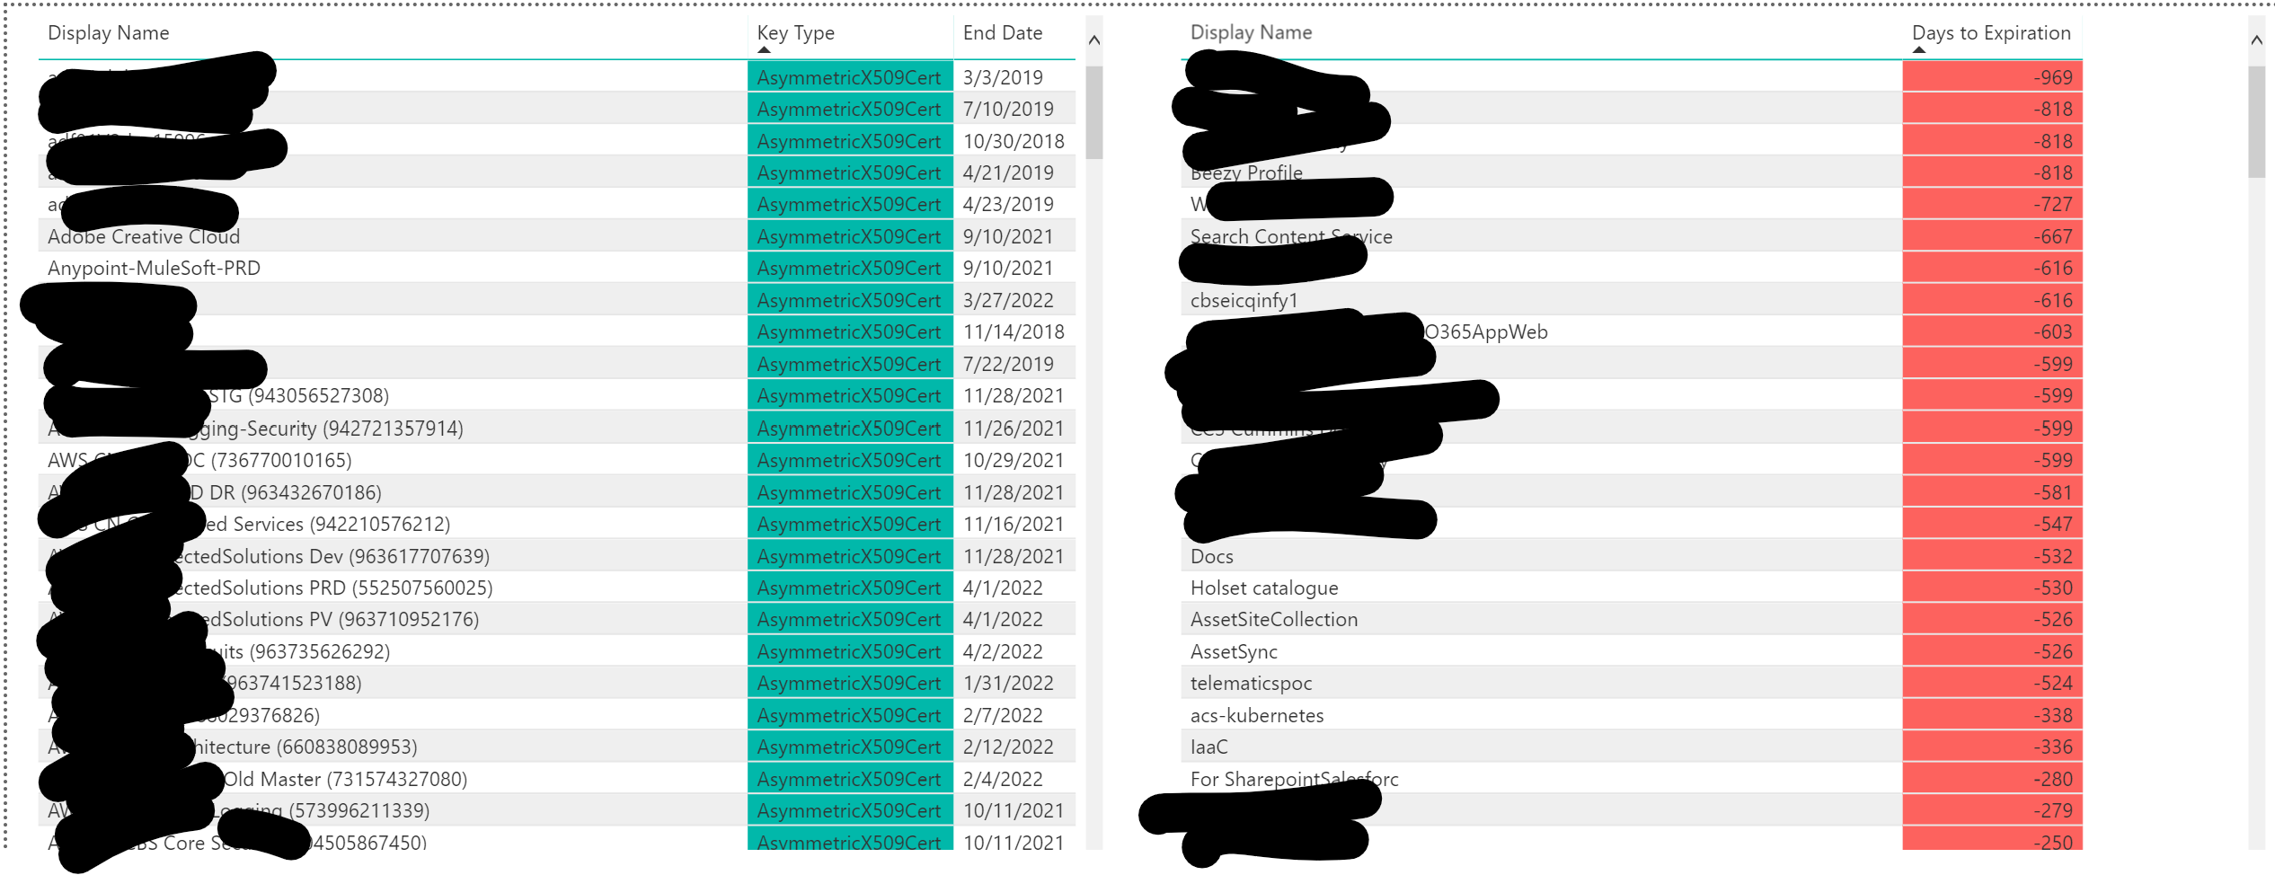
App Keys

Slide 28
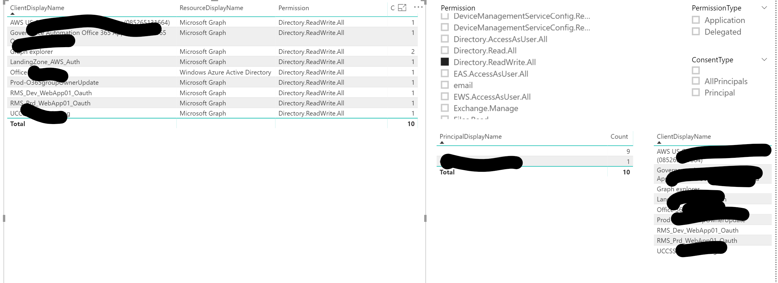
App Consents

Slide 29
Thank you.

